Slide 1
Writing Clean Code
AI2C Tech Intro

Slide 2
Objectives
Understand the importance of “clean code”
Identify “code smells”
Utilize tooling and processes to improve code quality
(buckle in)

Slide 3
They Write the Right Stuff
Effectively 0 bugs
Safety-driven
Exhaustive specification, collaborative agreements, rigid change control
The process is the product

Slide 4
The Agile Manifesto
We are uncovering better ways of developing software by doing it and helping others do it. Through this work we have come to value:
Individuals and interactions over processes and tools
Working software over comprehensive documentation
Customer collaboration over contract negotiation
Responding to change over following a plan
That is, while there is value in the items on the right, we value the items on the left more.

Slide 5
How do they compare?
Aspect | NASA Shuttle Software | Typical Commercial Software
Lines of Code | ~420,000 per version | Similar or greater
Error Count per Version | ~1 | ~100-1000
Change Control | Rigid, all changes must be agreed & documented | Flexible, often agile or approximate
Redundancy | Quadruple redundancy with voting system | Rare
Certification | Mandatory human sign-off before every launch | Usually no formal, legal gate sign-off
Design Philosophy | Blueprint-style specs; predict bugs early | Iterative deployment; fix bugs post-launch

Slide 6
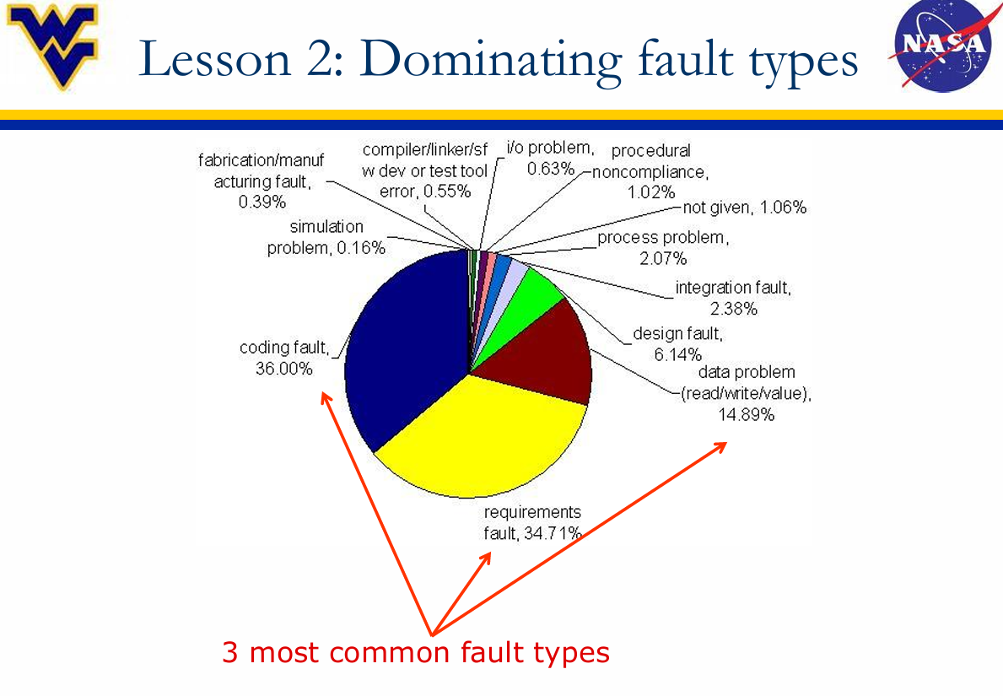
Does it matter?
Notes:
https://www.nasa.gov/wp-content/uploads/2016/10/585637main_swfaultsfailuresfixes.pdf
https://raygun.com/blog/costly-software-errors-history/

Slide 7
Reducing Coding Faults
Some thoughts & techniques

Slide 8
PEP 20
Beautiful is better than ugly.
Explicit is better than implicit.
Simple is better than complex.
Complex is better than complicated.
Flat is better than nested.
Sparse is better than dense.
Readability counts.
Special cases aren't special enough to break the rules.
Although practicality beats purity.
Errors should never pass silently.
Unless explicitly silenced.
In the face of ambiguity, refuse the temptation to guess.
There should be one-- and preferably only one --obvious way to do it.
Although that way may not be obvious at first unless you're Dutch.
Now is better than never.
Although never is often better than *right* now.
If the implementation is hard to explain, it's a bad idea.
If the implementation is easy to explain, it may be a good idea.
Namespaces are one honking great idea -- let's do more of those!

Slide 9
PEP 8
Python Style Guide
Covers
Indentation
Docstrings
Long code lines
Whitespace in a line
Comments
Naming conventions
And more!
Why is style important?

Slide 10
Don’t Repeat Yourself (DRY)
Duplicate code is more likely to have errors, especially during changes
If you ever find yourself copying & pasting code in multiple places…
Probably a good candidate for a function
Or a loop

Slide 11
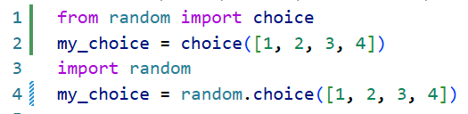
Packages & Modules
Packages bundle functionality into an installable artifact
A package can have multiple modules
Packages are any directory with a file called `__init__.py`
Every python file is effectively a module
Easy way to bundle your code and share with others for re-use
Notes:
https://docs.python-guide.org/writing/structure/#modules

Slide 12
Design Patterns
Creational – How do we make objects?
Structural – How do we structure our objects?
Behavioral – How do our objects interact?
Notes:
Just an intro that these ideas exist
https://refactoring.guru/design-patterns/catalog

Slide 13
Objects, Inheritance, Composition
OOP is a powerful way (to shoot yourself in the foot)
Composition over inheritance
Promotes loose coupling
Notes:
https://dev.to/romansery/why-you-should-favor-composition-over-inheritance-57m6

Slide 14
So what’s the deal?
How do you apply these ideas?
Notes:
We’ll look at select examples moving forward

Slide 15
Tooling and Techniques
Techniques
Tooling
Software Design Processes
Code Reviews
Test Cases
Pair Programming
Static analysis
Formatters (black)
Linters (pylint)
Dynamic analysis
Debuggers
Profilers
Repository analysis
Pre-commit hooks

Slide 16
Hands-On #1
Use an autoformatter to style code
Use a linter to identify problem areas
Setup pre-commit hooks to handle issues before commits
Write unit tests to validate functionality – if time permits

